Slide 1
Lecture 2: Domain Engineering
Gregory Gay
TDA 594/DIT 593 - November 3, 2022

Slide 2
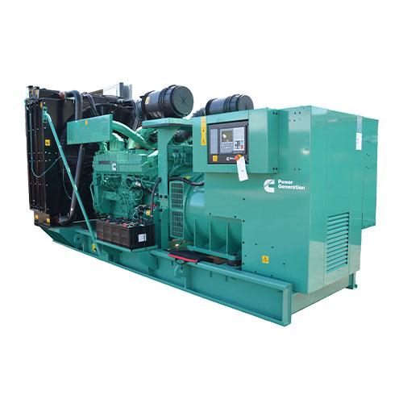
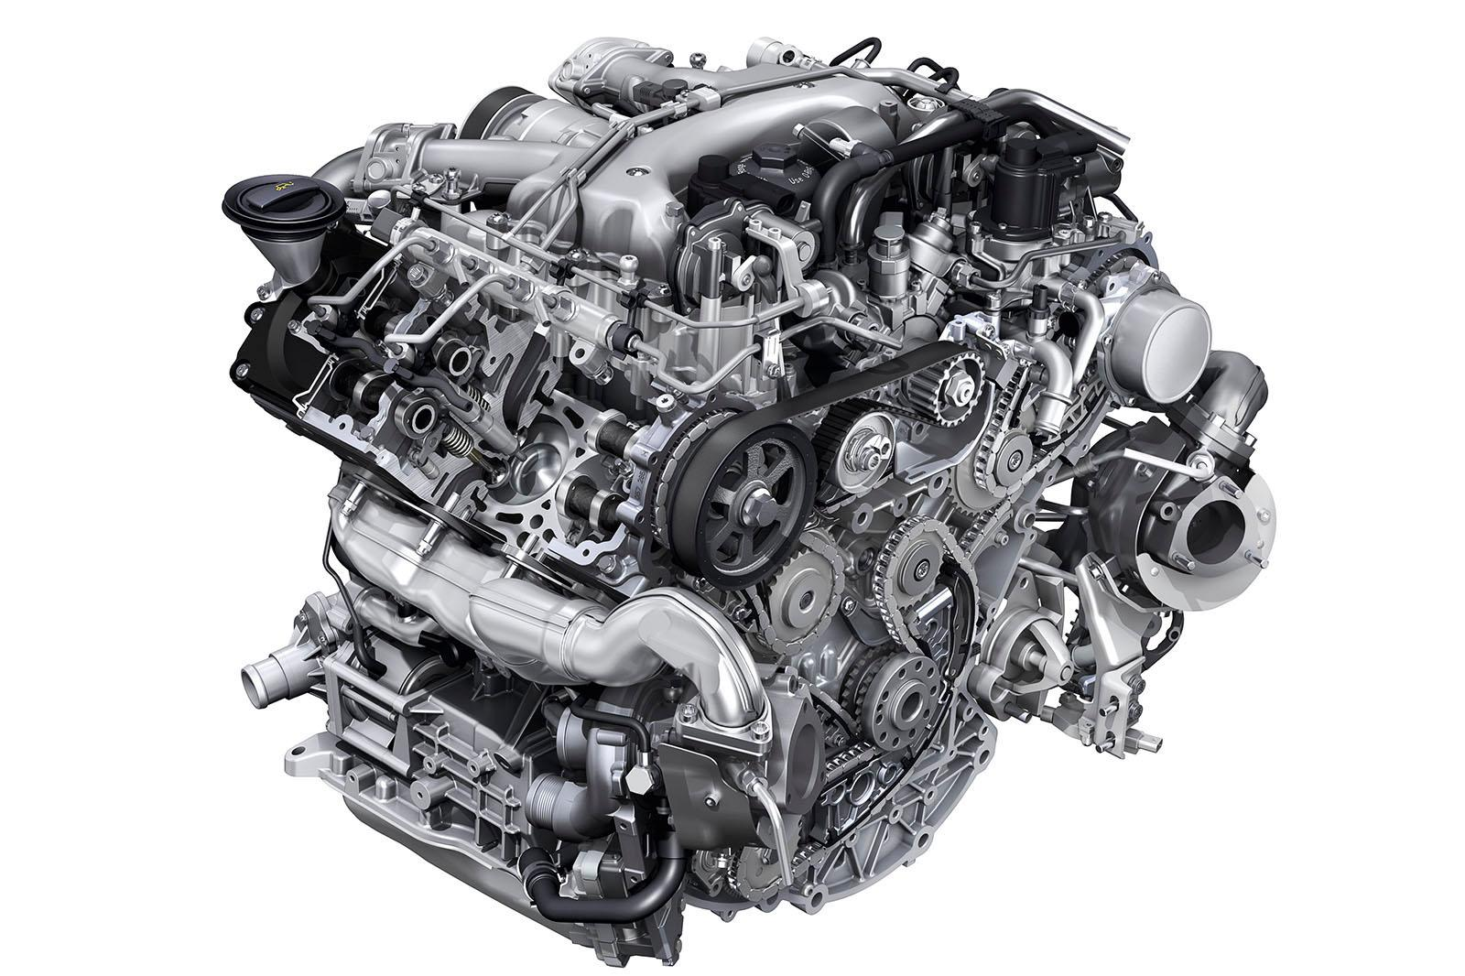
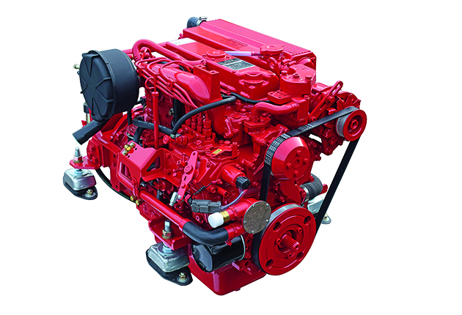
Software Product Lines (SPLs)
Highly configurable families of systems.
Built around common, modularized features.
Common set of core assets.
Allows efficient development, customization.
Core Platform
Notes:
as a reminder, a SPL is a system designed to yield a set of related software products, developed from a common set of core, reusable assets in a planned way. By developing large software systems in this way, companies can produce a set of products more economically, since the development effort put into the shared assets does not need to be duplicated. SPLs can also help companies to better address product customization tasks to meet specific needs of individual customers. This allows sustaining a high rate of product innovation, while keeping guaranteed levels of overall system performance and quality. SPLs are seen in many domains, and are highly challenging to develop as they have technical, process, organization, and business-related aspects. SPLs are built at Volvo or Boeing, Linux and Android are SPLs, and in many other circumstances. Most systems today are SPLs in some form whether or not the term is used - components are designed for reuse, systems are designed to be highly configurable, and designed to adapt and change over time to meet the needs of evolving markets by easily swapping out elements with standardized interfaces. All of these circumstances require similar design techniques and tactics to enable variation and change over time

Slide 3
Today’s Goals
Introduce Domain Engineering
Domain and Application Engineering
Platform vs Specific Product
Design FOR and WITH reuse
Principles of SPLE
BAPO: Business, Architecture, Process, Organization
Domain Modelling
Notes:
This class is, to some extent, structured like a software development process, We will talk about requirements and design, then testing, for software product lines and other complex reuse or modularity-driven systems. So, as a starting point, we’re going to begin with the development process itself. Not the basics, agile vs waterfall vs spiral, etc, but some considerations and planning and adaptation of traditional development phases that need to take place to create SPLs or similar systems. We will (1)(a process of developing Software Product Lines and other complex systems) (rest)

Slide 4
Domain and Application Engineering
Notes:
So, let’s talk about the design process for such systems.

Slide 5
Core Development Activities
Requirements:
Planned Behavior and Constraints
Design:
System Architecture
Classes
Packages
Communication Between Components
Interfaces
Realization:
Software Development
Testing:
Observe the System to Ensure Requirements Met
Notes:
When we develop software, there are four core activities that we pursue. We arrange these in different ways in different processes - and these activities break down into often MANY sub-activities- but we always do four fundamental things: requirements, design, realization, and testing. (click) In requirements, we decide what the software should do when it is done. What are its core features, what should all the outcomes of activating each feature be depending on the the specific input, and what constraints must the system follow when in service? We decide those during requirements. (click) We then transition to design, where we decide what the structure of the actual code should be. What are the core sub-systems within the overall system, how do those subsystems communicate and interact. Within each subsystem, what are the classes? What is each class responsible for? What is the package structure? Here, we architect the system and decide on how the requirements will be realized. (click) We then have to actually write the code. We do this in the realization phase. (click) Finally, in testing, we ensure the code actually does what we promised in the requirements. We execute different input against the system, record observations, and use those observations to make the argument that the system is - eventually, possibly after fixing bug after bug - finally ready to release. This is the traditional set of activities we perform for any single piece of software.

Slide 6
Domain and Application Engineering
Requirements
Domain Engineering
Design
Requirements
Realization
Design
Core Platform
Testing
Realization
Testing
Application Engineering
Requirements
Design
Realization
Testing
Notes:
In product line development, we are no longer talking about a single piece of software. When we develop a product line, we intend to produce many, many specific pieces of software from a platform of common assets. Instead, we have a two life cycle model, where we perform these activities for the core platform first. This is what we call domain engineering. We plan, design, implement, and test a core architecture and core assets that can be customized and put together in different ways to create many concrete products. Then, for each concrete product, we perform these four activities in a drastically simplified form. We call this application engineering. We create requirements, assemble assets,make any one-off changes we need, and perform product-specific testing to produce each concrete application.

Slide 7
SPLE Principles
Variability Management
Variability must be planned for.
Business-Centric Development
Connect to long-term business strategy.
Architecture-Centric Development
Take advantage of system similarities.
Two-Life-Cycles
Domain Engineering, then Application Engineering.
Notes:
Four principles govern successful product line engineering, and transform these four activities in various ways. Variability management: individual systems are considered as variations of a common theme. This variability must be made explicit and must be systematically managed. Business-centric: software product line engineering aims at thoroughly connecting the engineering of the product line with the long-term strategy of the business. Architecture-centric: the technical side of the software must be developed in a way that allows taking advantage of similarities among the individual systems. Two-life-cycle approach: the individual systems are developed based on a software platform. These products – as well as the platform itself – must be engineered and have their individual life-cycles. Development FOR reuse comes before development WITH reuse, so we perform development based on whether it is development of assets that are part of the platform ,which takes place during domain engineering, then the development of single products that use those assets, and we refer to that lifecycle as application engineering

Slide 8
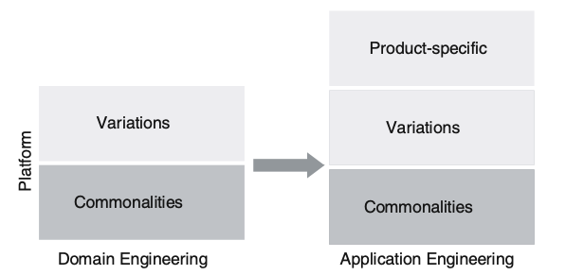
Variability Management
Commonality
Shared between all products.
Implemented in core platform.
Variations
Shared by subset of products.
Implemented in core platform, enabled in subset.
Product-specific
Unique to a single product.
Platform must support unique adaptations.
Notes:
product line engineering supports a range of products customized to differen customers or usage types. As a result, variability is a key concept. Instead of understanding each individual system all by itself, product line engineering looks at the product line as a whole and the variation among the individual systems. This variability must be defined,implemented, evolved throughout the entire lifecycle. we distinguish three main types of variability: Commonality: a characteristic common to all products in the product line. This can be requirements, code blocks (methods, to classes, to services and subsystems, any asset. This is then implemented as part of the platform. 2) Variation: a characteristic or asset common to some products, but not to all. It must be implemented in a way that allows having it in selected products only. 3. Product-specific: a characteristic part of only one product – at least for the foreseeable future. While these will not be integrated into the underlying platform, the platform must be able to support them. During the life-cycle of the product line, a specific characteristic may change in type. A product-specific characteristic may become a variability, if it looks like a piece of code we might want to reuse in a different product. A commonality may become a variation as well – for example, if over time the decision is made to support alternatives to that asset (e.g. extending the platform beyond the initial operating system, so some versions now are on iOS while others are on Android - now we have options that we choose form based on the OS). Commonalities and variabilities are handled mostly in domain engineering, when we develop the assets of the platform, and product-specific parts are handled exclusively in application engineering because they are tied to one product.

Slide 9
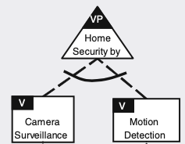
Reasoning about Variability
Variation Point
Where one product can differ from another.
Ex: Which features are supported by this security alarm?
Feature
Options that can be chosen at each variation point.
Ex: Motion detection, camera
Notes:
Variability management covers the whole life-cycle. It starts with the early steps of scoping and requirements, covering all the way to implementation and testing and finally going into maintenance and evolution. variability is relevant to all assets throughout software development. So, it is something we will return to and discuss often. This means that there are some terms to introduce that we can use to reason about variability. Variation point: the variation point describes where differences exist in the final systems (e.g. systems may differ with respect to the operating systems they rely on, with respect to whether they support a particular feature or not, which algorithm a feature uses, etc.) For example, we may have a security alarm product line that can perform different types of detection. Which are supported by a concrete alarm? This is essentially where you make a choice between the different possibilities that exist to satisfy a variation point , what we call features or sometimes variants.

Slide 10
Features and Products
Any end-user-visible characteristic or behavior of a system is a feature.
(often, functionality a user can directly interact with)
A concrete product is a valid feature selection.
Fulfills all variability and feature dependencies.
Notes:
Features are the concerns of primary interest in product-line engineering. A feature is a end-user-visible - that’s key - characteristic or behavior of the system (2). Features are used in product-line engineering to specify and communicate commonalities and variabilities, the differences, of the products between stakeholders and designers, and to guide structure, reuse, and variation across all phases of the development life cycle. The product portfolio of a product line is defined by its features and their relations. A specific product is identified by a subset of features, called a feature selection. A product of a product line is specified by a valid feature selection (a subset of the features of the product line). A feature selection is valid if and only if it fulfills all variability and feature dependencies.

Slide 11
Constraints on Variability
Variability Dependencies
Dependencies between features at one variation point.
How many features can we choose for this point?
Which are mandatory? Optional?
Feature Dependencies
Dependencies among features at any variation point.
Choosing one feature requires choosing or excluding another feature.
Notes:
We need to discuss the dependencies introduced by a variation point. Not all feature selections are valid and specify meaningful products, and two types of dependencies are used to decide what is a legal selection. First, Variability dependencies are how we denote the different choices (features) that are possible to fill a single variation point. This generally refers to the number of features that can be selected simultaneously (e.g. a program may support e-mail, text, phone for delivering a notification). We also note which features are mandatory and which are optional add-ons. In the last slide, we had that security alarm. You might require that all models have a camera, while making the motion detection feature optional.
Feature dependencies describe dependencies among certain feature selections. the selection of a specific feature may require the selection of another feature (perhaps for a different variation point, but somewhere in the concrete system, choosing one feature requires also choosing another). Or the selection of a specific feature may prohibit the selection of another feature. We talked about that security alarm. We have products that have different selections of detection features. One has a camera, another has a camera and motion detecter, and another has a motion detecter and microphone. Maybe we can’t get one with a microphone and camera. That is an invalid selection.

Slide 12
Fate of New Requirements
Should requirements for a concrete application become part of the product line platform?
If supported by the platform, add it to the platform.
(can be added as an asset or tied to a variation point)
Else:
1) Drop it.
2) Add a new variation point to the platform.
3) Develop it as a unique part of one application.
Notes:
As new requirements are captured during application engineering, each requirement must be considered and a decision made about its future: should it be a requirement of the platform and become a variation part there – or should it just be part of this concrete application? The simplest case is when the underlying platform already supports this requirement. Maybe this new featue can be chosen at an existing variation point. In that case, we just need to incorporate it, so it can be bound at compile, execution, or run-time. If the requirement is not supported by the infrastructure - maybe it is an entirely new feature, there are three different possibilities: 1) we could drop or replace it. this may sound strange from a customer-satisfaction perspective, but it needs to be decided. the more variabilities we must support, the more difficult the evolution of the infrastructure gets. 2) The new requirement should be integrated with the infrastructure - maybe adding a new variation point where we can choose between options to be expanded on in the future. or 3) this is truly something application specific, and not to be part of any additional products. In Case 2, we step back into the role of domain engineering - implementing this requirement as part of our overall asset portfolio and infrastrucute. In the third case, we remain in the application engineering role, developing it as part of this particularp roducrt. Typically, all three cases occur for different requirements in the same system development

Slide 13

Business-Centric Development
Up-front planning and investment required.
Long-term return on investment?
Implement requirement as part of platform or in a product?
3+ concrete products: make it part of platform.
Notes:
Because of the long-term investment and planning required to create the asset platform, Product line engineering can only be successful if the product line infrastructure is in the long term an reasonable way to bring new products onto the market efficiently. As a consequence, development decisions for the individual product are linked to the product line as a whole. Because of this strong linkage, it is important that the major business goals for the product line are well understood. The specific set of goals that provides the basis of product line engineering is going to influences decisions about when a requirement should be implemented and whether it should be implemented for the product line as a whole or only for a specific product. As a rule of thumb, the break-even from a cost-point of view is about three concrete products. When three or more concrete realisations of a requirement are required, it is usually more cost-effective to implement it once as part of the product line platform.

Slide 14
Scoping
Product Portfolio Planning
Which products are we going to make?
How do they differ?
Domain Potential Analysis
Will we get ROI on platform creation?
How complex should the platform be?
Asset Scoping
Which specific components will be part of the platform?
Notes:
So, a major part of scoping is decisions about which functionality to include in the product line or a concrete product. First, during planning we must determine the specific products and their functionalities that will initially be supported by the product line infrastructure. We need to catpure the products that will be part of the product line and identify their main requirements. we come up with a first overview of commonalities and variations of the products we plan to build. Domain potential analysis looks at the potential of the product line domain or specific sub-domains to identify whether a promising case for product line engineering exists. Here, we focus on the analysis of an area of functionality to determine whether investing in product line engineering makes sense. The key issue of this step is always to get a systematic answer to the question of where reuse investments should be focused. Would we get that return on investment from building a platform. Then, what are the key things we should engineer as part of the product line, and what can be left to the individual products? Finally, asset scoping defines the individual components to be built for reuse. In order to define these components, two view- points must be brought together- business and of architecture. what makes economic sense and what makes sense implementation-wise?

Slide 15
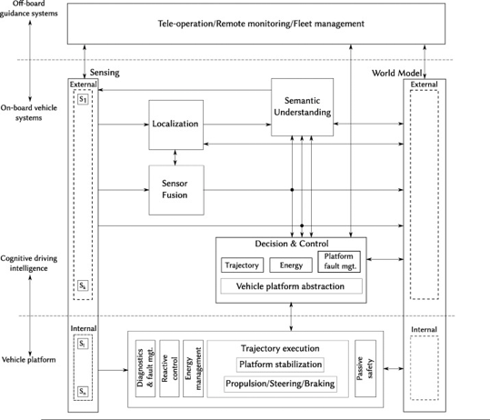
Architecture-Centric Development
Product lines use reference architectures.
Common architecture for all products.
Features follow the same interface standards to make them swappable.
Used to create a specific product architecture.
Notes:
Product line engineering relies on a common architecture (also called reference architecture). All concrete products we build from the core platform have the same basic structure, where we plug-in different components at variation points - usually with each feature implementing a common interface for that variation point. That way, the variants can be swapped at a variation point because they follow the same interface. A common architecture defines a single environment for all components that are used in the individual products . This ensures that there is no need to develop multiple components that address similar functionality, and differ only with respect to the environment they work in.each time we create a new concrete product- the reference architecture provides the basis for the derivation of the specific product architecture. this product architecture is mainly derived by instantiation of the generic assets. Referenece architectures are the key for the overall success of product line engineering. They make it easy to support and control variability and give you the means to control the complexity of the product.

Slide 16
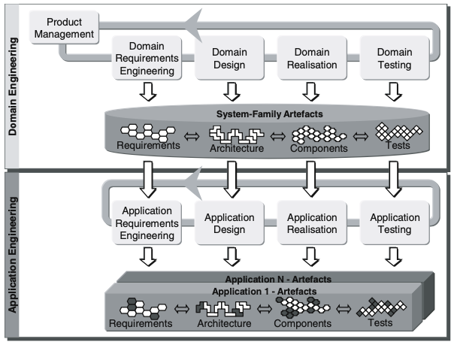
Domain and Application Engineering
Domain Engineering
Enables reuse.
Basis for creating individual products.
Requirements, design, code, etc. all planned for variability.
Notes:
The key difference between traditional development and product line engineering is that shift from the individual product to many. This shift implies a shift in development strategy. It relies on a distinction of development for reuse - preparing code with the intention of using it in multiple circumstances - and development with reuse - simply making use of assets. Development FOR reuse follows a process we call domain engineering, with provides a basis for the development of the individual products, the creation of a platform and its assets. This is followed by application engineering - development WITH reuse - which makes use of those assets. The product line infrastructure encompasses all assets that are relevant throughout the development life-cycle. The assets cover the whole range from the requirements to architecture and relization to testing. We plan from the start for variability. For example, the requirements may contain an explicit description of specific requirements that apply only for a certain subset of the products, and we make that clear in the requirements.

Slide 17
Domain and Application Engineering
Application Engineering
Development based on reuse.
Builds product on top of platform.
<= 90% of product built from assets.
Notes:
Application engineering (development with reuse) builds the final products on top of the product line infrastructure. Application engineering is strongly driven by the product line infrastructure, which usually contains most of the functionality required for a new product. The variability explicitly modelled in that infrastructue provides the basis for deriving the individual products. Basically, when a new product is developed, an accompanying project is set up. Then requirements are gathered and directly categorised as being either part of the product line or product-specific. Then the various assets (e.g. architecture, implementation, etc.) may be instantiated right away, leading to an initial product version. At this stage in the development, up to 90% of the product may be available from reuse; only the remaining 10% must be developed in further steps. Now, something to keep in mind here is that, with adaptation and careful planning, that asset portfolio can include assets you built yourself, or increasingly, microservices built to be adaptable from the start, with well-defiend APIs

Slide 18
What is a Domain?
An area of knowledge.
Scoped to maximize requirement satisfaction.
Encompases distinct concepts
Defines how to build systems in this area.
High-Level Domains: databases, social networks, supervised learning, …
Social network subdomains: message board, text chat, voice chat, video streaming
Notes:
A key success factor is to set a proper focus on a particular, well-defined and well-scoped domain for your product line. Broadly, a domain is an area of knowledge that: is scoped to maximize satisfaction of the requirements of its stakeholders, encompasses a distinct set of concepts and terminology understood by practitioners in that area, and includes and defines the knowledge of how to build systems (or parts of systems) in that area. More concretely, what does that mean? A domain is a set of systems that have something in common. At a high level, we might consider databases to be a domain, social netwokrs, supervised learning systems, Often, you can dive further from there. The broader the domain, the smaller the set of similarities among products. Although there are similarities that could be exploited in social networks, for example, there are also great differences. Facebook, Discord, Reddit, and Twitch might all be considered social networks. They have some features in common, but also individual systems have substantial differences, which decrease potential for reuse of assets between them. If we were building a social network platform, we might want to narrow our focus to support a smaller subset of those types of social networks to increase the reuse potential, while keeping maintenance effort acceptable, so we might choose to focus on video streaming for our platform and be able to develop multiple specialized products that share certain assets like the chat that appears alongside the video while also allowing customization of other elements.. The bottom-line is that a proper scoping is essential. But, broadly, we start by deciding on, scoping, and examining the domain we are interested in.

Slide 19
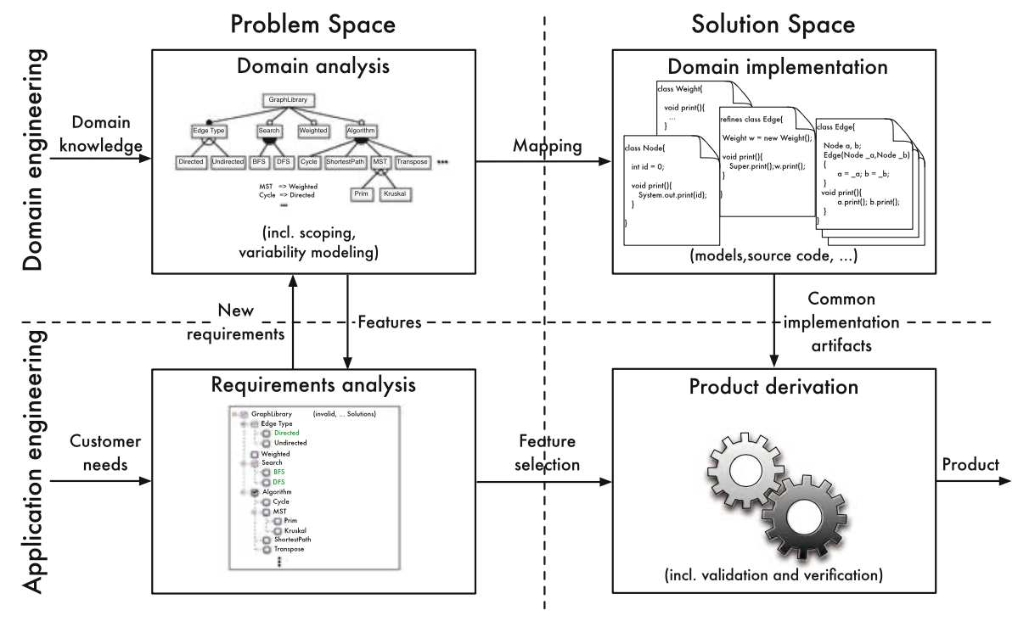
Problem and Solution Space
Problem Space
Stakeholder view
Characterized by features
Solution Space
Developer view
Characterized by code structure
Implementation of features.
Notes:
A development process for product lines has to take the idea of a domain - a set of related, but differing systems - into account. Two issues play a crucial role: the explicit handling of variability and the systematic reuse of assets. For both, it is important to have an appropriate structuring of process and software artifacts. The specific characteristics of product lines lead to a separation between domain engineering and application engineering and between problem space - ideas and concepts- and solution space - the actual code we write. The distinction between the problem space and solution space highlights two different perspectives. The problem space takes the perspective of stakeholders and their problems, requirements, and views of the entire domain and individual products. Features characterize the problem space. The stakeholders are interested in what externally-visible functionality they can interact with. In contrast, the solution space represents the developers perspective. It is characterized by the code structure - the functions, classes, and program parameters. The solution space covers the design, implementation, and verification of features and their combinations in suitable ways to facilitate systematic reuse.

Slide 20
Key Task Clusters
Develop reusable assets.
Requirements for the entire product line (scope, features)
Assets combined to form new concrete product.
Map requirements to feature selection, assess new requirements
Notes:
The distinctions between domain and application engineering and problem and solution space give us four clusters of tasks: 1) (click) Domain analysis is a form of requirements engineering for the entire product line. Here, we need to decide the scope of the domain, that is, decide which products should be covered by the product line and, as a result, which features are relevant and should be implemented as reusable artifacts. The results of domain analysis are usually documented in a feature model. 2) (click) Requirements analysis investigates the needs of a specific customer as part of application engineering. In the simplest case, a customer’s requirements are mapped to a feature selection, based on the features identified during domain analysis. If additional requirements are discovered, they can be fed back into domain analysis, which may modify our feature model (and, eventually, the reusable artifacts in our asset portfolio). 3) (click) Domain implementation is the process of developing reusable assets that correspond to the features identified in domain analysis, including source code and test cases. 4) (click) Product derivation is the implementation step of application engineering, where reusable assets are combined to form a new concrete product. Domain engineering is performed once for the entire product line, whereas application engineering is performed for every individual product. A goal of product-line engineering, in general, is to move development effort as much as possible from application engineering to domain engineering. For example, if quality assurance (such as code inspections, testing) can be done in domain engineering instead of looking at individual products, costs can be dramatically reduced. A major goal of feature-oriented product lines is to fully automate product derivation, although some customization effort is almost always needed.

Slide 21
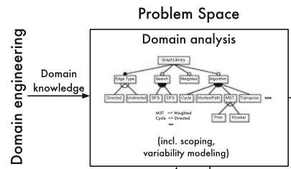
Domain Analysis
Domain Scoping
Deciding on extent of product line
Features to support.
Trade-off between effort and customer range.
Ex: Embedded Database Domain
Definite Features: Transactions, Recovery, Encryption, Queries, Aggregation, Multi-OS (eCos, TinyOS, Linux),
Out-of-Scope: Cloud Storage
Consider: Multi-User Support
Notes:
Domain analysis is requirements engineering for the whole product line. It is concerned with the problem space, ideas over implementation. It contains two primary tasks: domain scoping and domain modeling. Domain scoping is deciding on a product line’s extent and range. We decides which of all possible requirements in a domain should be considered. The scope describes features or specific products that should be supported. if our domain is embedded database systems, we might decide which hardware architectures to support- ARM, RISC, etc. During scoping, experts collect information about the domain, for example, by analyzing existing systems or interviewing customers. We then decide on the limits of our product line. product lines with a small scope are easier to develop and maintain, as they result in similar products with few variations and a lot of reuse. However, the broader the scope and the more feature, the more customers can be satisfied. So, there is a trade-off between implementation effort and potential use cases. The trade-off requires careful consideration, including looking at revenue, customers, and imeplementation costs of each feature. For example, In the domain of data management for embedded systems.What features do we need to cover? transactions, recovery, encryption, and basic queries, also support for multiple embedded OSes (TinyOS, Linux, Android). By focusing on embedded systems, several features are outside the scope: remote storage (cloud storage) may not be viable. Other features are not obvious. For example, we might consider whether to include security (user and access management) as an optional feature. It might open up multi-user support, but the number of customers interested not be huge. We might decide to exclude the feature from the scope, as the potential revenue does not cover the required implementation and maintenance costs.

Slide 22
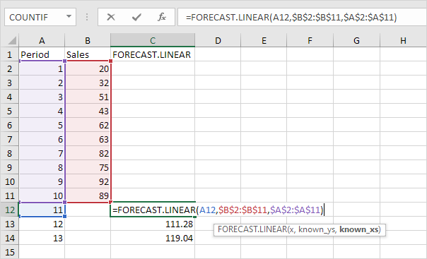
Example: Spreadsheets
Look at existing products: Excel, Google Sheets, …
What are some features a user would expect?
Notes:
(1-2) discuss in chat
formulas, conditional formatting (numbers, dates), text formatting (colors, bold), chart creation, summation, sorting of data, input/output of file formats (CSV, open office, excel, pdf), data backup to prevent corruption
Some of these have options we could choose from (text formatting options, may support some but not others - same for I/O formats) or different ways to perform calculations

Slide 23
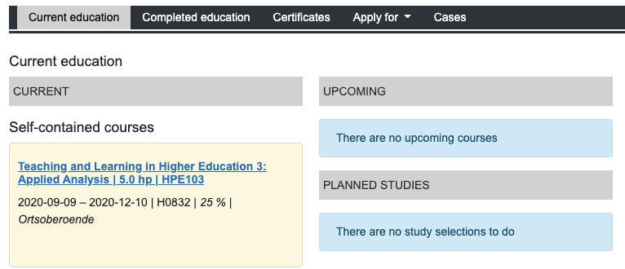
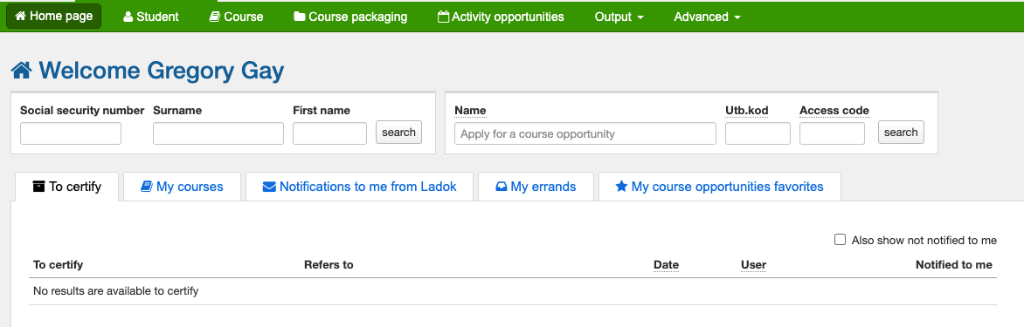
Example: Student Data Management (Ladok)
Product Line: Student App, Teacher App
Notes:
Consider management of student course and grade data, like what you’d see on Ladok. What features does a product line for this domain need to offer?
Here, we need to consider two stakeholder perspectives - students and teachers. Our product line could serve both using a common platform, with a different interface and certain features enabled
Student functionality - see grades (shared), see completed courses, see upcoming courses, apply for degrees or certificates, add degrees/ceritifcates/credentials
Teacher functionality - see grades for a student (shared), enter grades, certify grades, see past courses taught (could be shared with seeing past courses taken - we could associate course records with a profile in a flexible manner)

Slide 24
Domain Analysis
Domain Modeling
Document commonalities and differences between products in terms of features and dependencies.
Ex: Embedded Database
Features: Storage, Transactions, OS (Android, Linux), Encryption
Storage, OS are mandatory.
Only one OS selection supported per product.
Notes:
Domain modeling captures and documents the commonalities and variabilities of the scoped domain. As a first step,we might give examples for possible products, as well as counter examples documenting which products are and are not in the scope of the product line. Then, commonalities and differences between desired products are identified and documented in terms of features and their mutual dependencies, this is the feature modeling we will talk about more today. For example, in the domain of embedded data management, we identify Storage, Transactions, OperatingSystem, Encryption as features to support. Only Storage and OperatingSystem are mandatory, all other features are optional. An example for restricting the possible products is that we cannot select more than one supported operating system at the same time.

Slide 25
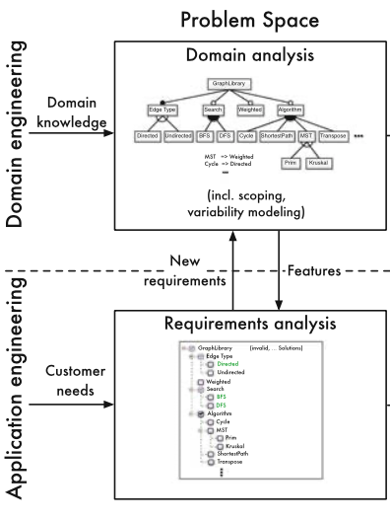
Requirements Analysis
Map customer requirements to domain requirements.
If requirements do not map to existing features:
1) Out of scope
2) Do much as possible with features, customize rest
3) Extend platform with new features, variation points.
Notes:
During Requirements analysis, we solicit the customer’s requirements through interviews and document analysis. We can build on the knowledge gathered during domain analysis. There, we already identified possible requirements in the domain, so we try to map the customer’s requirements to those identified earlier during domain analysis. Ideally, requirements analysis can be reduced to the selection of existing features, such that a product can be assembled using reusable assets. If a customer’s requirement cannot be mapped to one or more existing features, we can do one of three things. We can decide that the requirement is out of scope. Not our job. 2) We can assemble the next best product without this feature and extend with custom extensions. We invest additional implementation effort during application engineering, which may not be integrated back into the product line. Or 3) we can decide to change our product line and include the additional requirements as new features or new variation points.Additional work on a single product is cheaper in the short term than developing a new feature for all future products, but it may be of benefit in the long term to add it to the product line for all products. In our embedded database example, Suppose we have a database product line with features for query processing and transaction support. If, during requirements analysis, we learn that a customer wants an SQL-based, multi-user, client- server environment, we can map some of these requirements to existing features for query processing and transaction support. However, we might not support a multi-user environment. We could add that to this one product, or we could revisit our platform and add multi-user support as a feature for the whole product line.

Slide 26
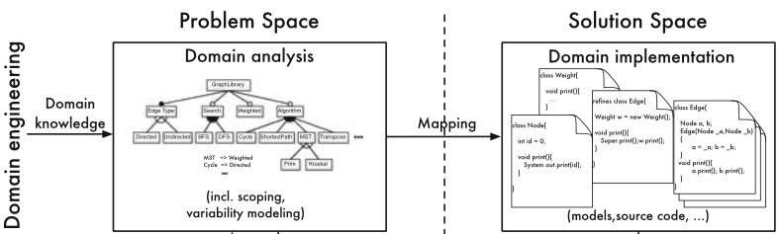
Domain Implementation
Implement reusable assets from domain requirements.
Strategy for combining modules.
Compile-time: only include requested code
Run-time: include all code, activate when executed
Interfaces for “attaching” variable features.
Notes:
After identifying features, we want to implement them in the form of reusable artifacts. Domain implementation targets the solution space, as we are now working in technical terms - code structures, architecture, classes - to the domain requirements. The implementation process requiores several considerations beyond just writing code. First, we need to select a general implementation strategy to be able to reuse these assets. For example, we could include or exclude variable code conditionally at compile-time or activate/deactivate specific features at runtime. Or build a framework with plug-ins that can be combined on demand. Depending on the implementation strategy, we might need to prepare the design and code such that we can hook in feature implementations. How do we register specific assets to the system for a particular product.

Slide 27
Product Derivation
Build the final concrete product from reusable assets.
Add any necessary customization.
Ideally, can be done automatically.
Often requires some manual “glue” code.
Notes:
Finally, we build the concrete product from reusable assets, adding any additional custom implementation necessary. Ideally, a produc can be composed solely using the assets we already developed.In most cases, many parts of the implementation have been prepared already and can be reused, but the combination of the artifacts requires some manual work, in which developers still have to write glue code to connect the assets and to patch up the gaps. The resulting product usually has to be verified before being delivered to a customer by running tests derived from artifacts during domain engineering.

Slide 28
Let’s take a break!
Notes:
Just start with a question - want you to start thinking about this. (read)
This isn’t something with one answer, or even a right answer. It’s something we’ll keep returning to

Slide 29
Two-Life-Cycle Approach
Domain Engineering
Develop reusable assets
Designed for long-term, complex development.
Application Engineering
Develop products.
Designed for current customer, rapid changes.
Notes:
Let’s bring all of this together. Domain engineering focuses on the development of reusable assets. Domain engineering continues as long as the product line exists, so the underlying development process must be able to cope with long-term, highly complex system development. Application engineering focuses on the development of the individual systems on top of the platform. A large part of development effort is moved to domain engineering,so application engineering won’t need to cope with so much complexity and development will not span so much time as in domain engineering. Application engineering is directly involved with the customer and will often need to deal with much more rapid changes than in domain engineering. As a consequence, a development process that is able to cope rapidly with changes is required.

Slide 30
Domain Engineering Activities
Product Management
Portfolio planning, economic analysis.
Creates product roadmap.
Requirements Engineering
Requirements for the platform, identification of variation points/features.
Notes:
The activities within domain engineering are : 1) Product management defines the products we will produce from the platform. In particular, it identifies the major commonalities and variations. 2) Domain requirements engineering: this activity produces a comprehensive analysis of the requirements for all planned products in the product line. It captures these requirements, identifies commonalities and variations and constructs an initial domain model - including specification of the variation points and features - which supports the further development steps.

Slide 31
Domain Engineering Activities
Domain Design
Create reference architecture.
Domain Realization
Implement reusable assets.
Domain Testing
Test assets in isolation, generate test input for concrete products.
Notes:
3) Domain design: starting from the requirements model, this activity develops the product line architecture (the reference architecture). It provides the basis for all future implementation work. 4) Domain realisation: this activity encompasses detailed implementation of the reusable assets. 5) Domain testing: this aims at verifying the generic, reusable components that were implemented as a result of the previous activity. we focus on testing the assets in isolation. In addition, domain testing also generates reusable test cases that can be reused in application testing. We must be careful to verify these assets again in the context of the concrete application

Slide 32
Application Engineering Activities
Requirements Engineering
Requirements for the specific product, starting from existing variabilities.
Application Design
Instantiates reference architecture, adds specific adaptations.
Notes:
Application engineering, then, consists of the following activities: 1) Application Requirements Engineering: This aims at identifying the spe- cific requirements for an individual product, while trying to stay as close as possible to the existing product line infrastructure. 2) Application Design: This activity derives an instance of the reference ar- chitecture, which conforms to the requirements identified in the previous step. On top of this product-specific adaptations are designed.

Slide 33
Application Engineering Activities
Application Realization
Reuse and configure existing assets, build new components.
Application Testing
Test new components and integration of reused assets.
Notes:
3) Application Realisation: Based on the available requirements and architec- ture, the final implementation of the product is designed and developed. This includes reuse and configuration of existing components as well as building new components corresponding to product-specific functionality. 4) Application Testing: In this step, the final product is verfiied against the application requirements. Similar to the previous steps, this builds on reusable assets from the corresponding domain activity. So, we integrate reused components into the new system, test new components, and test the integration of all components.

Slide 34
Feature Diagrams
Notes:
Let’s talk about the most common way to model the domain, what are called Feature Diagrams

Slide 35
Features and Feature Dependencies
Generally a functionality of the software.
Can be mandatory or optional.
Features are connected by their relationships.
Selecting A allows B to be selected.
Selecting A requires B to be selected.
Variation Point: Selecting A requires selecting one of (B, C, D).
A feature model describes these relationships.
Notes:
A feature model documents the features of a product line and their relationships. Any end-user-visible characteristic or behavior of a system is a feature, but we are usually referring to a function of the software. A feature can be mandatory - always part of a product, mandatory in some circumstances - so, mandatory based on the other features we select - or optionally selected. A feature can be connected to another feature through different relationships, and Features are not always freely combinable. Not all features may be compatible, and some features may require the presence of other features (for example, “A must always be selected” and “B implies C”). if we select one feature for a product, this may enable the option of including a second feature. Alternatively, selecting one feature may REQUIRE the selection of a second feature. Earlier, we mentioned variation points where we choose between different options. A variation point is a feature, with multiple options connected to it and the ability to choose one or more of these options. A feature model describes relationships between features and defines which feature selections are valid.

Slide 36
Identifying Features
Aspects of the domain reflected in the software.
Externally-visible functions of software.
Aspects of non-functional behavior that can be controlled.
(energy consumption) “Precision” vs “Battery-Preserving”
(disk usage, memory) How often data is saved
Must represent a distinct and well-understood aspect of the system.
Notes:
To identify features for your product line, you must think carefully about the domain you are trying to capture. The first step is to consider functionality. What are the broad functions of the software, whether mandatory to all products you produce from this product line, or included in particular configurations. In cases where you will provide alternative choices, what are the options that can be selected from? In some cases, you may also want to capture non-functional aspects of the system as well, especially if those can vary. For example, one can often trade accuracy and precision of the result of a calculation for more battery life. In this case, you might consider “precision mode” and “battery-preserving mode” as features that could be selected, naturally in opposition to each other - they would be options for a variation point perhaps regarding energy consumption. Or, we might have settings for how often data is written to the disk, prioritizing memory usage versus disk usage. One of the most important characteristics of a good feature is that it needs to represent a distinct and well-understood aspect of the system. Good features need to precisely describe customer-relevant functionality. It should not be something that is vague to either customers or developers.

Slide 37
Understanding a Feature
To model a feature, consider:
Description and requirements
Relationship to other features
(hierarchy, ordering, grouping)
External dependencies (hardware, software)
Configuration knowledge (activated by default?)
Constraints (requires feature X, excludes Y)
Effect on non-functional properties
Attributes (number, parameters)
Potential feature interactions.
Notes:
A feature is more than a name; in domain modeling, one has to look at other properties of features. Here is an (incomplete) list of potential information that domain experts can collect on features that may impact modeling:
Description of a feature and its corresponding (set of) requirements, Relationship to other features, especially hierarchy, order, and grouping, External dependencies, such as required hardware resources or external software libraries, Configuration knowledge, such as ‘activated by default’, Constraints, such as “requires feature X and excludes feature Y”, All kinds of behavioral specifications, including invariants and pre- and postcon-ditions, Known effects on non-functional properties, such as “improves performance and increases energy consumption”, Additional attributes, such as numbers and textual parameters, used for further customization during product generation, and Potential feature interactions

Slide 38
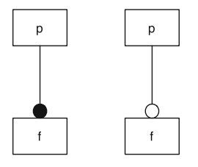
Feature Diagrams
Tree where nodes represent features.
Shows parent-child relationship.
F can only be selected when P is selected.
Parent tends to be more general, child is more specific.
Parent - Sensor, Child - RADAR
Mandatory Feature
Optional Feature
Notes:
Feature diagrams are a visual representation, whose elements also have meaning in propositional logic. Feature diagrams define a feature model as a hierarchy of features and constraints among them. It is a tree whose nodes are labeled with feature names. Different notations convey parent–child relationships between features and their constraints. If a feature f is a child of another feature p, f can be selected only when p is also selected. Typically, a feature diagram includes mutual relations between features. For example, the parent feature denotes a more general concept and the child a specialization. For example, the parent might be “Sensor” - a abstract concept, and a child might be “RADAR” a specific kind of sensor. On the left, The parent node is labeled with p, the child node with f. If a feature f is a child of another feature p, f can be selected only when p is also selected. Mandatory and optional features are distinguished by a small circle on the child node—a filled bullet denotes a mandatory feature, whereas an empty bullet denotes an optional feature.

Slide 39
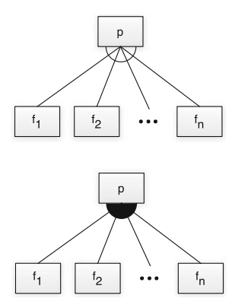
Feature Diagrams
Alternative (mutually exclusive choice): Choose exactly one
Mandatory Feature
Optional Feature
Or: Choose at least one
Notes:
Specific graphical elements define additional constraints, if the child features of a common parent cannot be selected independently. The top and bottom right show graphical notations for disjunctive combinations. On the top right, the edges between a parent feature and a group of child features are connected via an empty arc. This graphical element denotes a choice of exactly one feature out of the group (that is, choose one from {f1 ... fn}). In propositional logic, it is an xor statement, choose exactly one. This construct is called alternative or mutually exclusive choice. Typical examples of exclusive disjunctions of features are different implementations of the same functionality or different technical platforms such as the choice of the supported operating system. The bottom right shows child features connected via a filled arc. This graphical element denotes an unrestricted choice of one or more features out of a feature group. It is chosen if, at least, one feature of the collection has to be selected, but there are no other restrictions. Mathematically, it denotes an inclusive disjunction (an or statement).

Slide 40
Cross-Tree Constraints
Cross-tree Constraints are predicates imposing constraints between features.
DataDictionary ⇒ String
(Storing a data dictionary requires support for strings)
MinimumSpanningTree ⇒ Undirected ∧ Weighted
(Computing a Minimum Spanning Tree requires support for undirected and weighted edges)
Constraints over Boolean variables and subexpressions.
(i.e., (NumProcesses >= 5))
Notes:
The notational elements of feature diagrams support a natural description of a wide range of variability options, but not all. More general restrictions are needed in the form of propositional logic constraints. Typical constraints are implications between features located in different parts of the feature hierarchy, for example, to express that a certain algorithm requires a special data structure or that a certain function is not available for a certain operating system. Those additional constraints may span large parts of the feature diagrams and so we call them cross-tree constraints. for example, For embedded data management, storing an explicit data dictionary requires the support of the String data type to store attribute names (2), or For a graph library, a typical cross-tree constraint would be that the computation of minimal spanning trees requires undirected, weighted edges to be supported (4). LArgely, we will focus on named Boolean features as an introduction, but non-Boolean features or attributes of features may also be of interest. For example, in a system supporting parallelization, the number of supported processes may lead to different products, and we might have constraints defined over the number of processes

Slide 41
Example - Data Management
Data Management System
Top node represents the system itself.
OS
Storage
Access
Hierarchy goes from general/abstract to specific.
First layer represents “types” of functionality.
Notes:
Let’s do some examples. We’ll start with a system for data management. As I mentioned, a feature diagram is arranged hierarchically, with groups of features, features related to those, then features related to the next layer, and so on. We start with a top node, which just represents the system itself that we are building and not a feature of that system. Now, as I mentioned, we tend to move from the more abstract or general down to more concrete and specialized, so for the second layer (click), we have three very abstract concepts. These are not necessarily concrete features, but will - as we will see shortly - represent independent types of functionality that we have in the system. We have functionality related to access, storage, and operating system interfacing. All three of these have filled circles, indicating that they are mandatory. no matter what, we will have some kind of functionality related to these three.

Slide 42
Example - Data Management
Data Management System
OS
Storage
Access
API
Transaction Log
SQL Engine
put
get
post
delete
relational queries
stream queries
Notes:
Ok, let’s look at the access features. (click) At the first layer under access, we have three features. Two are optional, they have an empty circle. Some of our products may have a transaction log, some will not. Some will have an SQL engine, some will not. API have a filled circle, it is mandatory. All products will have an API. Under API, we have some options for what features the API has. (click) This is a REST API, but not all of our products will have functionality for a given command.Get is mandatory. All of our products will have an API, and that API will always let you get data. Otherwise, we may or may not include put, post, and delete. We also have some options for an SQL engine (click). This engine can have stream-based queries, and it can have relational queries. Both are optional. We can have both if we want - they are independent of each other.

Slide 43
Example - Data Management
Data Management System
OS
Storage
Access
Data Dictionary
Indexing
Tables
Columns
List
B+-Tree
add
search
remove
update
Notes:
Now, let’s look at the storage features. (click) We are going to have some form of data dictionary and some form of indexing. Both are mandatory - filled circle. (click) Now, for the data dictionary, we have two options tables or columns, you are going to store data in one of these forms. You will notice that this is an unfilled circle. That means that you must choose exactly one of these, not both, and not 0. So, the data dictionary is mandatory, and it must use either tables or columns. For indexing (click) we can index in different forms, and these are not mutually incompatible. Notice the filled circle, that means we choose one or more. We can choose List, B+-Tree, or both. Then, if we choose B+-tree, we also have some optionals features for the data structure (click). if we choose the B+-tree, We MUSt have add and search functions (filled circle). We can also have, but are not required to have, update and remove options (unfilled circle).

Slide 44
Example - Data Management
Data Management System
OS
Storage
Access
Windows
Linux
MacOS
Notes:
Finally, let’s look at OS interfacing. This one is pretty simple, but is another example of the unfilled fan - this is a mutually exclusive choice. You must choose exactly one of these, and not more than one.

Slide 45
Example - Website Configuration
SPL that provides website functionality.
One feature - adjusts layout based on the device.
What other aspect of the site could be features?
Consider visual appearance and personalized content.
Website Configuration
Visual Appearance
Layouts
Mobile
Tablet
Desktop
Notes:
Let’s do another example together. Let’s say that we want to build a platform that can control the visual appearance of our website. For example, it might present different layouts on a desktop, mobile phone, and a tablet. So, one feature is a layout selector, with the options tablet, desktop, and mobile. What other features might this product line have? Think about a website that changes its functionality or appearance under different circumstances. Or one that allows personalization of the content. What are the different options that can result in different configurations of the site? (discuss)
Appearence: - images - full quality, low quality, text-only - color scheme - light mode, dark mode
Content: - cookies - all, only essential, none - advertising - targeted, non-targeted, none - languages - english, swedish, norwegian
- account features - logged in, not logged in -> change password, personalized content, edit account details

Slide 46
Example - Website Configuration
Website Configuration
Content Personalization
Visual Appearance
Layouts
Dark Mode
Mobile
Tablet
Desktop
Notes:
Appearence:
- images - full quality, low quality, text-only
- color scheme - light mode, dark mode

Slide 47
Example - Website Configuration
Website Configuration
Content Personalization
Visual Appearance
Account Features
Languages
Advertising
Cookies
Swedish
English
Essential
None
All
Change Password
Edit Account Details
Standard
None
Targeted
Personalized Content
Notes:
Content:
- cookies - all, only essential, none
- advertising - targeted, non-targeted, none
- languages - english, swedish, norwegian
- account features - logged in, not logged in -> change password, personalized content, edit account details

Slide 48
We Have Learned
Domain Engineering
Development FOR reuse. Creates asset portfolio.
Provides basis for creating individual products.
Requirements, design, code, etc. planned for variability.
Application Engineering
Development WITH reuse.
Builds product on top of asset infrastructure.
Up to 90% of new product may be built from assets.
Notes:
(read)

Slide 49
We Have Learned
A product is a valid selection of features.
Feature models capture the constraints that define whether a selection is valid.
Feature diagrams represent feature relationships visually.
Propositional logic represents feature relationships as formulae that can be used in analyses.

Slide 50
Next Time
Feature Modelling and Analysis
Team Selection Due Tonight!
6-7 people, one email per team to ggay@chalmers.se
Complete assignment in Canvas
(include either team number given to you, or if you want to be assigned to a team)
Assignment 1 out now!

Slide 51
Assignment 1 - Case Study
Due November 13, 11:59 PM
Case study examining development of a SPL or other reuse-driven system.
Choose a system from case studies on Canvas
Notes:
In this assignment, you will create a case study examining the development of a Software Product Line (or another complex system that makes extensive use of reusable assets or external libraries, where alternative options could be chosen and configured). Many examples of SPL development are included in the following book: Van der Linden, F. J.,Schmid, K., & Rommes, E. (2007). Software product lines in action: the best industrial practicein product line engineering. Springer Science & Business Media. This book is freely available indigital form from the Chalmers library.However, you are not restricted to this book (which is somewhat old). You may also feel free tofind other SPLs or complex systems that make extensive use of reusable assets and externallibraries, and create a case study on the development of those systems. We recommend that you search specifically for companies that produce software product lines, but you may focus on any system that was clearly engineered to manage variability of some kind (e.g., a system that can be customized by a user or for a particular customer, a system where there are many configuration options, or a system designed to be plugged into an existing framework)
For example, manycompanies blog extensively about their products (i.e., Netflix - ​https://netflixtechblog.com/​ -Facebook - ​https://engineering.fb.com/​ - or Spotify - ​https://engineering.atspotify.com/​). Others have written white papers and participated in research studies (Danfoss, for example - https://dl.acm.org/doi/10.1145/2934466.2934491 - as well as Bosch and pure::variants). You are encouraged to do some preliminary research before you choose a system and may choose any company and system as long as sufficient information exists to analyze the engineering choices made in the development of that system.

Slide 52
Assignment 1 - Case Study
Document:
Context: What kind of organization/market?
Motivation: Why a SPL or reuse-driven approach?
Type of System
Approach: What engineering practices?
Challenges: Key technical and process challenges.
Results: What happened?
Conclusions: What did they learn?
Notes:
You must ensure that sufficient information is available on the chosen system to write this report before you begin the project.Before beginning your case study, you ​must​ obtain approval from your supervisor on yourchoice of system to study. A supervisor will be assigned following completion of Assignment 0(Team Formation), so it is in your interest to form a team as quickly as possible.When requesting approval, include your primary sources of information on the chosen system. If you are unsure whether enough information is publicly available on a system you are interested in, discuss this with your supervisor.
You will create a case study on the system of your choice. To guide your analysis, we present the following aspects regarding the system that you should consider●Context: ​What kind of organization adopted/applied SPL or reuse-driven engineering?●Motivation:​ What motivated the transition to or adoption of a product line or reuse-driven approach?●System Type:​ For what kind of system did they apply SPL or reuse-driven engineering?
●Approach:​ How did they adopt SPL or reuse-driven engineering? What practices were employed? What processes were affected, and how?●Challenges:​ What were the key technical or process challenges encountered when implementing SPL or reuse-driven engineering?●Results:​ What are the important results with regard to business, architecture, process,and organization?●Conclusions:​ What did they learn from implementing SPL or reuse-driven engineering?You may also write about other aspects of the system that you feel are relevant.
In addition to documenting information found about these systems, you should reflect on the choices made by the engineers building these systems and provide your own commentary and opinions on those choices. Do you feel these were reasonable decisions? Do you see potential weaknesses in the decisions made? Are there alternatives you feel should have been considered? We do not expect you to design a perfect system, but you should discuss the work performed by these companies in the context of your own experiences or in the context of other systems that you have read about.There is not a minimum page length for this document. Quality is more important than quantity.It is important that you cover the criteria in detail, and provide your own reflections on the development of the chosen system. Any questions? Again, this is due Nov 14, but don’t wait to get started. This will take a bit of research and thought to get right.

